Slide 1


Working in Trinity
Eimear Rouine
  Transition to Trinity Officer

Slide 2


Getting set up to work in Ireland.
You will need:
An Irish Bank Account and
A PPS Number
  A PPS Number is a Personal Public Service Number.
  All workers in Ireland must have a PPS Number
  If you receive an employment offer you will need to apply for a PPS Number in order for you to be set up with the Irish Revenue service. You will need to register your number on revenue.ie to get your documents quickly
  You cannot apply for a PPS Number until you have received an employment offer
  If you do not have a PPS number you will be emergency taxed. This is approx. 50% of your earnings

Slide 3
Entitlements to work
EU/EEA Students
  You are entitled to work in Ireland either full- or part-time
Non-EU/EEA Students
  If you have an IRP Stamp 2B you may work up to 20 hours/week (during term) and 40 hours/week (holidays)
  Holidays are from December 15 – January 15 and June 1 – September 30
  If you have an IRP Stamp 2A you may not work

Slide 4








Minimum Wage
Workers’ Protections
Sick Leave
Annual Leave
Employment Rights
https://www.internationalstudents.ie/info-and-advice/know-your-rights/employment-rights

Slide 5
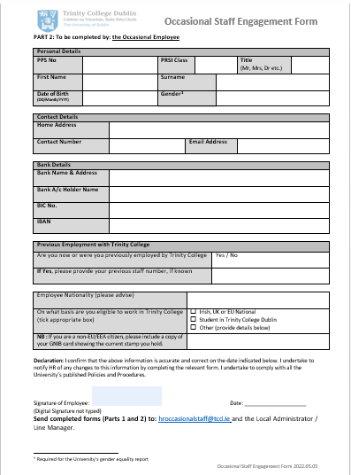
Getting Set Up to Work in Trinity
If you are going to work in Trinity, you will need to be set up with HR
Your manager will send you the Occasional Staff Engagement Form for you to complete Part 2 (page 3)
  https://www.tcd.ie/hr/assets/doc/occasional-staff-casual-engagement-setup-form.docx

Slide 6
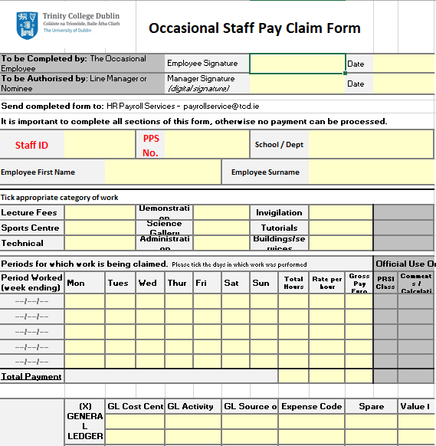
Getting Paid in Trinity
You will have to fill out a claim form for the hours you worked in order to get paid
    https://www.tcd.ie/hr/assets/excel/occasional-staff-casual-claim-form.xlsx
If you don’t sign it, put in your Staff ID or PPS Number you will not be paid!
Payday is last day of the month
Your manager must submit your claim form by the 6th of the month so make sure to send it through by the 1st of the month

Slide 7

Pay rates
Pay rates are set centrally in Trinity
  https://www.tcd.ie/hr/assets/pdf/occasional-lecturer-rates.pdf
When your manager sets you up on the original form they will tick which category you are and that will be your pay rate

Slide 8

Where to look for jobs in Trinity
Teaching/Demonstrating
The Library
Invigilation
Global Ambassadors
TAP
Students’ Union
SLD Shut Up and Write Facilitators (PhD)
Ad hoc opportunities (focus groups, tour guides, survey promotion… See PAS newsletter for details)
Check MyCareer for other opportunities

